Slide 1
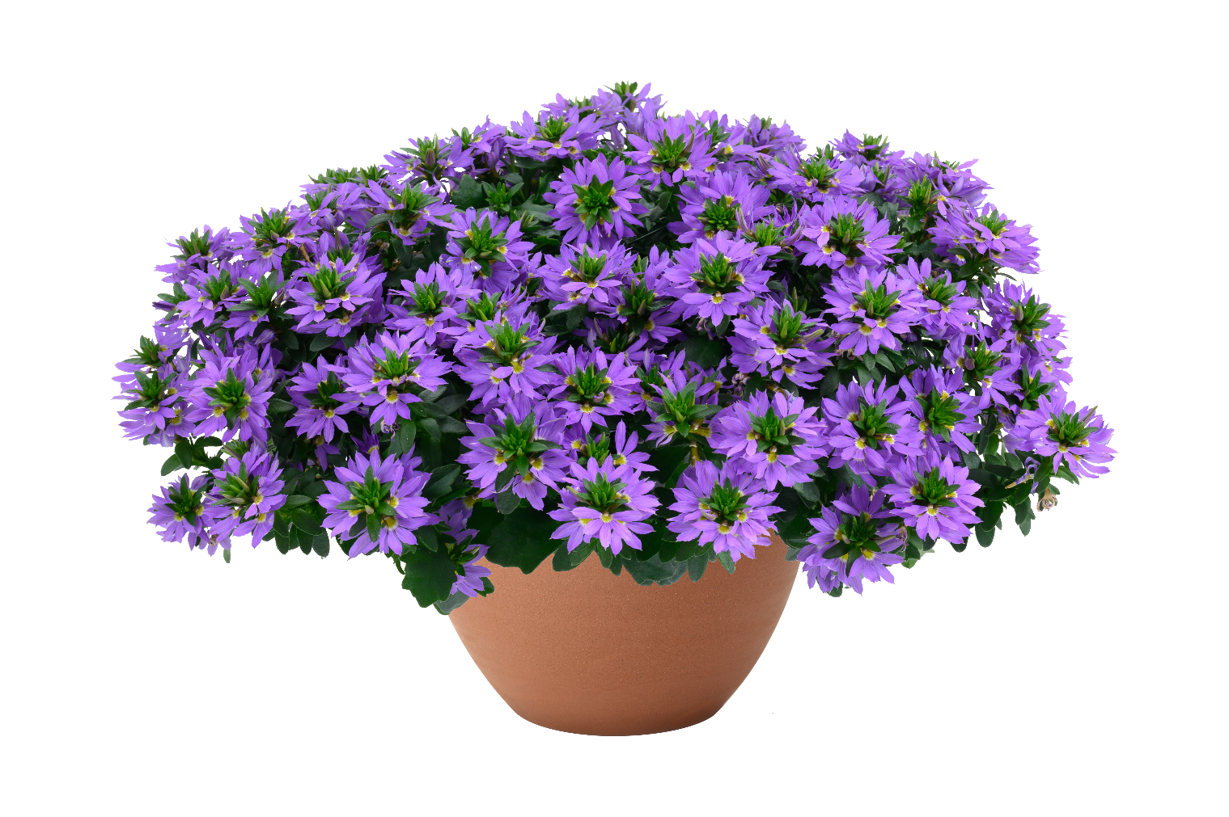








BALI™ Blue
Scaevola aemula
Early flowering variety- About 7 days earlier than touch
Naturally semi trialing habit
Abundance of flowers
Season extender
Great summer item
Well suited for handing baskets and combinations
Semi trialing |  | 20-25 cm 8-10 in |  | 25-41 cm 10-16 in |  | Heat tolerant
12-15 Qt, Gal |  | Landscape |  | Hanging basket

Slide 2


BALI™ Blue
For additional information and availability:
BALI™ Blue
Scaevola aemula
Number 4 out of 4 categories
Average Time | Temperature | Hormone | Fertilization | Fungicide
5 weeks | Weeks 1 - 3 72°-74° F (22° - 23°C) | Recommended | Weeks 1-2 50 ppm N | Spray fungicide to control Botrytis and bacteria day of sticking
 | Weeks 4 - 5 68° - 70° (20° - 21° C) |  | Weeks 3-5 100-150 ppm N | Apply broad spectrum Week 2
Rooting | pH | EC | Temp | Feed | Light | PGR | Fungicide | Comments
Week 1 | 5.8/6.2 | 0.80 | 72°-74° F (22° - 23°C) | 50 ppm N in mist | Not required |  | Day of sticking
Week 2 | 5.8 to 6.2 | .80 to .90 | 72°-74° F (22° - 23°C) | 50 ppm N in mist |  |  | Second fungicide app
Week 3 | 5.8 to 6.2 | .90 to 1.0 | 72°-74° F (22° - 23°C) | Feed 100 ppm to 150 ppm
Week 4 | 5.8 to 6.2 | 1.0 to 1.2 | 68° - 70° (20° - 21° C) | Feed 100 ppm to 150 ppm
Week 5 | 5.8 to 6.2 | 1.0 to 1.2 | 68° - 70° (20° - 21° C) | Feed 100 ppm to 150 ppm |  | Daminozide/ uniconzolel as needed |  | Daminozide @ 2000 to 2500 ppm
Misting specification - Remove from mist as soon as possible​
Do not over-mist or saturate soil - Spray adjuvant at sticking ​
Maintain warm temperatures allowing plants to develop.
Spray Daminozide at 2000 to 2500 ppm or apply Uniconzole 2-5 ppm if required
Pinch is optional recommended week 4 or at transplant

Slide 3

1801™
For additional information and availability:
BALI™ Blue
Scaevola aemula
Keep the temperatures moderately warm to allow plants to continue to have a good development (average daily temperature at 68 to 70 F (20 to 21 C).
Average Time (from liners) | Temperature | Pinch/ Daylength Modification | Fertilization | Plant Growth Regulator
6 to 7 wks | Average Day | pinch for better branching and uniformity - suggested Night interruption or extended day- Optional | 100-150 ppm N | Spray Daminozide @ 2500 to 3750 ppm Paclobutrazol drench @ 1 to 2 ppm
(12 cm) 5” pot | 68°-70° F (20°-21° C)
8 to 9 wks | 1 plant per pot |  | Soil EC 1.0 - 1.2 pH 5.8 to 6.2
(15 cm) 6 ½”
8 to 9 wks
(20 cm) 8 ” | 3 plants per container
Pests | Aphids | ACETAMIPRID, FLONICAMID, IMIDACLOPRID,DICHLORVOS
 | Thrip | METHIOCARB, ACRINATHRIN, ABAMECTIN, DICHLORVOS, SPINOSAD
Diseases | Botrytis | CYPRODINIL+FLUDIOXONIL, IPRODIONE, POLYOXIN
 | Pythium | PROPAMOCARB
 | Phytophthora | PROPAMOCARB
Finishing | pH | EC | Temp | Feed | Light | PGR | Fungicide | Comments
Week 5 Transplant | 5.8 to 6.2 | 1.0 to 1.2 | 68° to 70° F (20° to 21° C) | feed 100 to 150 ppm |  | B-9 as needed | Spray fungicide after transplant | Spray Daminozide @ 2500 to 3750 ppm
Week 6 to 13 | 5.8 to 6.2 | 1.0 to 1.2 | 68° to 70° F (20° to 21° C) | feed 100 to 150 ppm |  | Uniconzolel if required |  | Paclobutrazol drench @ 1 to 2 ppm
PGR - Spray Daminozide at 2500 to 3750 ppm for finishing plants
Uniconzole 2-5 ppm if required for finishing.
Drench a broad spectrum fungicide after transplant
Scout for Aphids and Fungus Gnats and Mites

